Slide 1
Porting to .NET Core

Slide 2
When Should You Port To .NET Core
Need .NET Core Features (e.g. Cross-Platform)
New Project
Able to Upgrade Individual Component / Service

Slide 3
When Shouldn’t You Port To .NET Core
Working Code, No Compelling Business Reason
Need Features Not In .NET Core (Pretty Few Now)

Slide 4
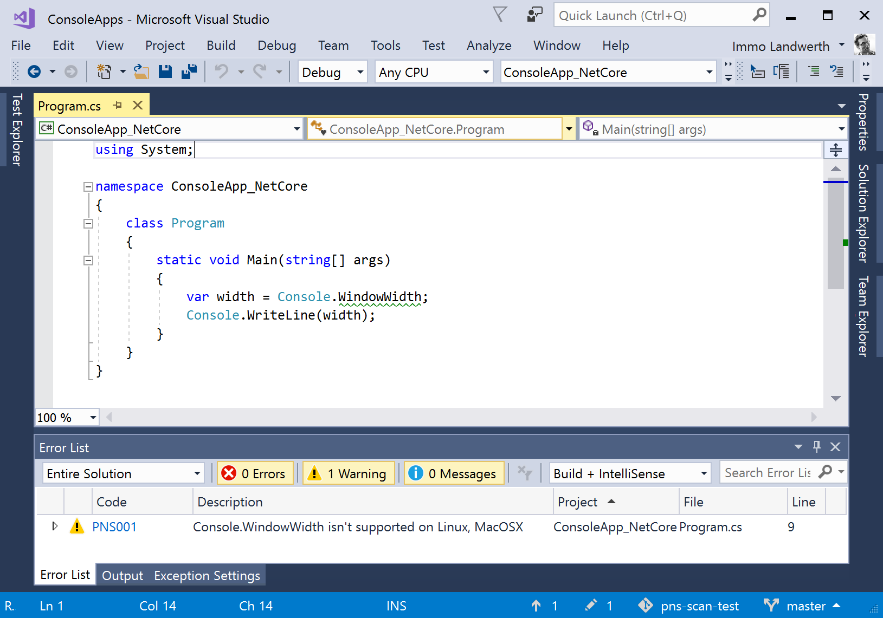
Platform-Compat Analyzer

Slide 5
Demo: Porting a Library
Notes:
Create a .NET Framework class library
Reference the NQuery NuGet package from this new library
Create a new .NET Standard 2.0 class library and copy the class library code in

Slide 6
ASP.NET Considerations
Modules / Handlers
Startup / Configuration
Front-end (static) files
Identity
Entity Framework (migrations, etc.)
Tool: Routing

Slide 7
Steps
Get ready
Learn with a new / internal application
Prepare Your Existing Application
Update to new release / patterns
Refactor to services
Test coverage (unit, integration, user interface)
Create a New Application
Select the nearest match
Copy / reference code

Slide 8
Lab: Porting an ASP.NET MVC 5 Application
Notes:
https://docs.microsoft.com/en-us/aspnet/core/migration/proper-to-2x/

